Slide 1
Optimisation/Minimisation
PHYS3112 – Tutorial 2

Slide 2
What is an Optimisation problem?
Imagine you had a function y = F(x)
You want to find the x that will give you the ‘best’ y. How?
There are many different methods that can be used to find the ‘optimum’ set of inputs.
For the sake of clarity, we will assume that the ‘optimum’ output is the one closest to zero – these are called minimisation problems.
DEMONSTRATION
Input(s)
SOME FUNCTION
Output(s)

Slide 3
Solution #1: Brute Force!
Try as many inputs as possible and pick the lowest (guess and check)
You can choose inputs in a systematic/structured way, or randomly.
PROs:
Very easy to code
You can be confident you have found the global minimum (more on this later)
CONs:
SLOW AF
Scales VERY poorly with increasing input dimensions

Slide 4
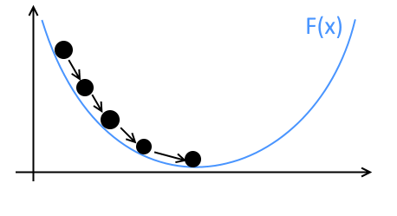
Solution #2: Gradient Descent
Gradient descent are a class of iterative solutions that use the function gradient.
At each guess, some form of gradient is computed, and this is used to decide the next guess
There are a LOT of implementations of this principle! The best choice depends on the nature of the problem
You should be able to code a rudimentary GD yourselves.

Slide 5
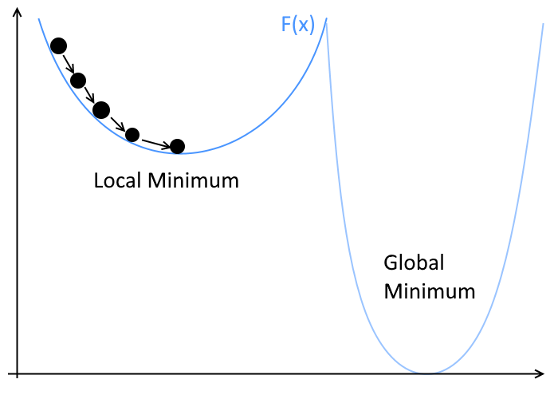
Global Vs Local Minimums
GD Solvers typically find the ‘bottom’ of whatever local potential they are in!
This means they tend to find the local minimum, instead of the global minimum.
Solutions?
Randomize the starting location – hope you get put in the global minimum potential?
Add some randomness into the descent process!

Slide 6
Solution #3: Simulated Annealing
A random/jumping search; from a given input position (a), we check the output status of a neighbouring position (b). We may decide to ‘jump’ to position (b).
We formulate an ‘Acceptance Probability’ P(a,b,T) is the probability that we will jump from a to b.
If b is a more favourable input position, we are more likely to jump to it.
However, there is still a non-zero probability of jumping to an unfavourable position – this likelihood is dictated by the ‘Temperature’ (T) of the system, which gradually lowers.
Our searcher is more likely to descend gradients, but still has sufficient randomness to jump between wells -> this increases the likelihood that we find the global minimum!

Slide 7
Things to Consider in your Choice of Method
To make a sensible decision as to our optimisation algorithm, we need to think about the problem.
Does the function evaluate quickly or slowly?
Can we evaluate the gradient of the function? How smooth do we expect the output to be?
Do we expect a single global minimum, or are there many local minimums to chose from?
Are our inputs discrete or continuous?

Slide 8
Framing other problems as minimisation problems
Sometimes you want to use someone else’s optimization routine (eg those found in scipy.optimize)
Sometimes you want to optimize something that doesn’t have an output that you can minimize (eg curve fitting, spectra matching).
With a mild extra effort, you can turn most optimization problems into minimization problems! To do this, you need to write a ‘wrapper’ function.
Importantly, the output of this wrapper function should be minimizable.

Slide 9
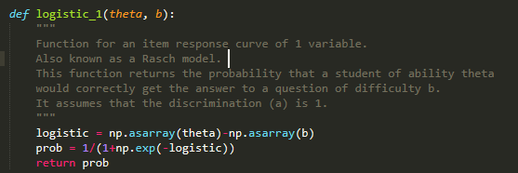
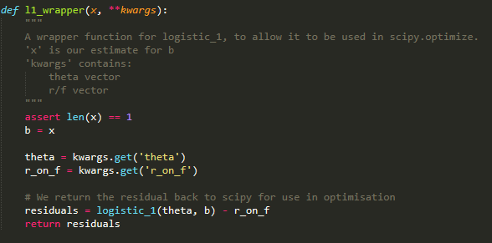
Wrapper Function Example: Curve Fitting.
I am trying to fit a curve of type logistic_1 to some data.
Logistic_1 is a function that defines my curve; for a given input (theta) and curve parameter (b) it will return a probability.
L1_wrapper that returns how good a guess for b (given as x) fits the data (theta and r_on_f, which are my x and y values).
I can pass this wrapper to a scipy.optimize and it will return the b that gave the smallest residuals

